Slide 1

Source Code: https://github.com/jkruskie/cis-355-intern-project
A SLICE OF
JOBCORSE

Slide 2

Composer

Slide 3
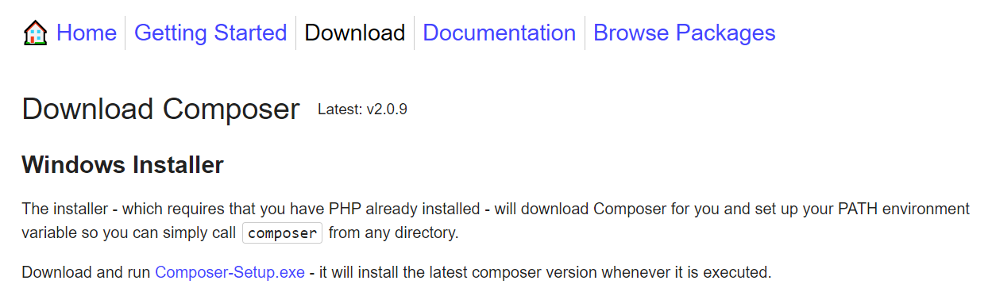
DOWNLOAD
https://getcomposer.org/download/

Slide 4
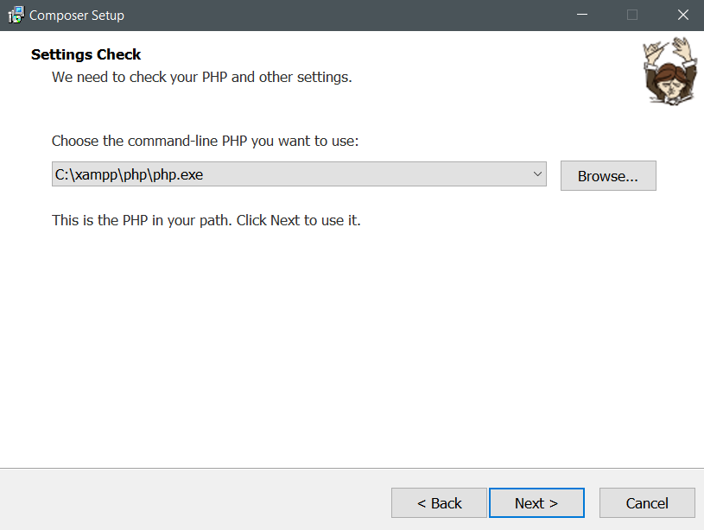
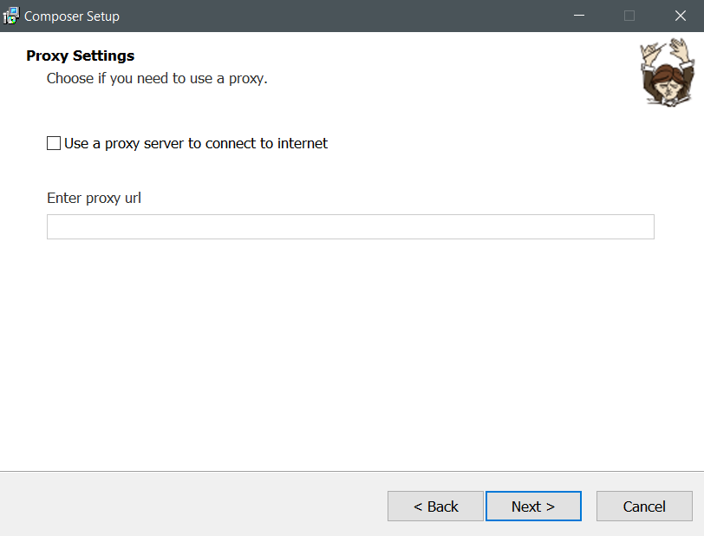
INSTALL

Slide 5
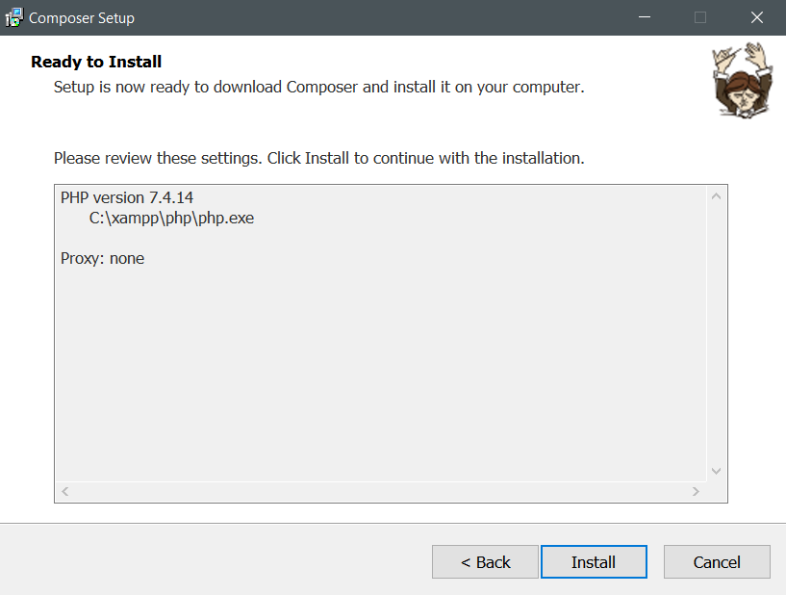
INSTALL

Slide 6
CakePHP

Slide 7
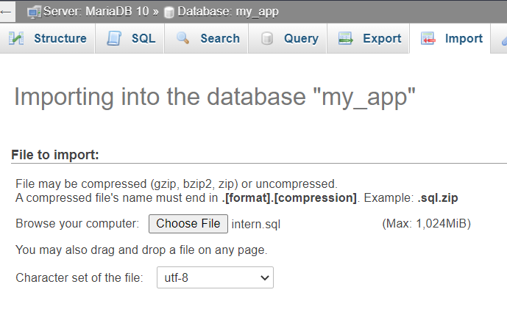
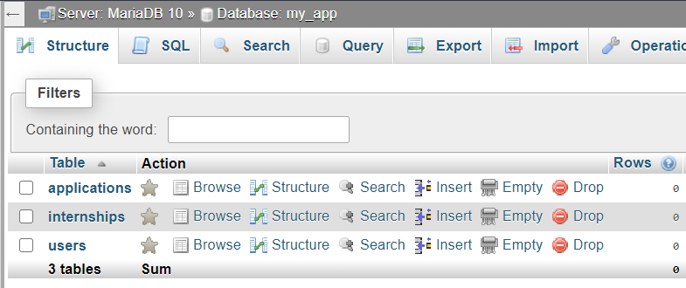
IMPORT SQL Structure
PHPMYADMIN
Select Database from left side of screen.
Click Import and Choose File. Select the intern.sql file from source code location: database\structure\intern.sql
Click Go

Slide 8
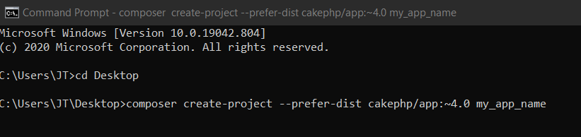
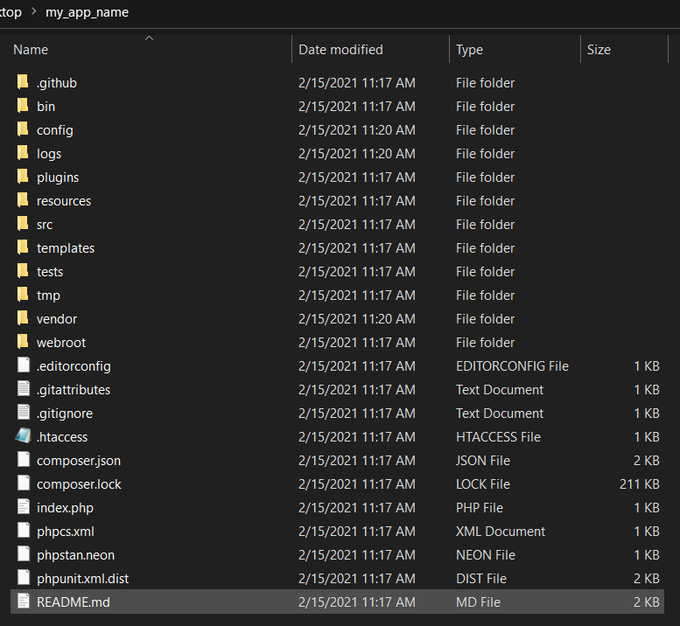
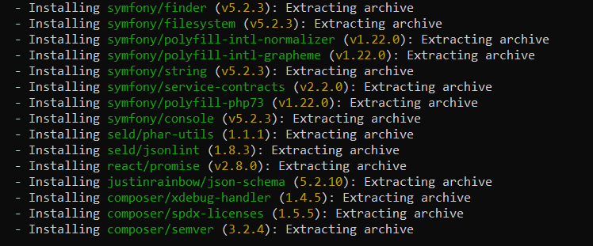
INSTALL
composer create-project --prefer-dist cakephp/app:~4.0 my_app_name

Slide 9
CONFIGURATION
/config/app_local.php
'Datasources' => [
'default' => [
'host' => 'localhost',
'port' => '3306',
'username' => 'username',
'password' => 'password',
'database' => 'database',
'url' => env('DATABASE_URL', null),
],
],

Slide 10
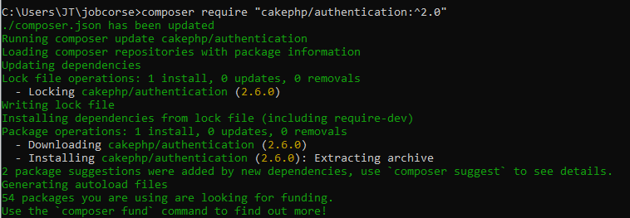
INSTALL
cd my_app_name
composer require "cakephp/authentication:^2.0"

Slide 11
CONFIGURATION
/src/Application.php
public function middleware(MiddlewareQueue $middlewareQueue): MiddlewareQueue
{
. . .
$middlewareQueue->add(new AuthenticationMiddleware($this)); // Add Authentication middleware
return $middlewareQueue;
}

Slide 12
CONFIGURATION
/src/Application.php
Namespace App;
use Authentication\AuthenticationService;
use Authentication\AuthenticationServiceInterface;
use Authentication\AuthenticationServiceProviderInterface;
use Authentication\Identifier\IdentifierInterface;
use Authentication\Middleware\AuthenticationMiddleware;
use Cake\Http\MiddlewareQueue;
use Cake\Routing\Router;
use Psr\Http\Message\ServerRequestInterface;
// Import authentication classes
class Application extends BaseApplication implements AuthenticationServiceProviderInterface // Implement Auth
{
public function bootstrap(): void
{
... // Load more plugins here
$this->addPlugin('Authentication’); // Add Authentication
}
} https://book.cakephp.org/authentication/2/en/index.html

Slide 13
CONFIGURATION
/src/Application.php
public function getAuthenticationService(ServerRequestInterface $request): AuthenticationServiceInterface
{
$service = new AuthenticationService();
// Define where users should be redirected to when they are not authenticated
$service->setConfig([
'unauthenticatedRedirect' => Router::url([
'prefix' => false,
'plugin' => null,
'controller' => 'Users',
'action' => 'login',
]),
'queryParam' => 'redirect',
]);
$fields = [
IdentifierInterface::CREDENTIAL_USERNAME => 'email',
IdentifierInterface::CREDENTIAL_PASSWORD => 'password'
];
// Load the authenticators. Session should be first.
$service->loadAuthenticator('Authentication.Session');
$service->loadAuthenticator('Authentication.Form', [
'fields' => $fields,
'loginUrl' => Router::url([
'prefix' => false,
'plugin' => null,
'controller' => 'Users',
'action' => 'login',
]),
]);
// Load identifiers
$service->loadIdentifier('Authentication.Password', compact('fields'));
return $service;
}

Slide 14
CONFIGURATION
/src/Controller/AppController.php
public function initialize(): void
{
parent::initialize();
$this->loadComponent('RequestHandler');
$this->loadComponent('Flash');
$this->loadComponent('Authentication.Authentication’); // Load Authentication component
}

Slide 15
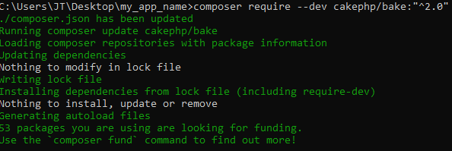
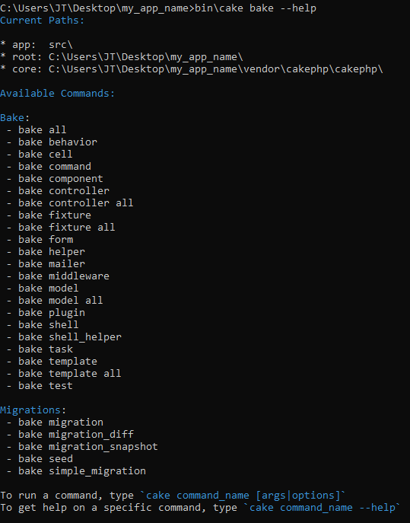
CODE GENERATION
composer require --dev cakephp/bake:"^2.0"
bin\cake bake --help

Slide 16
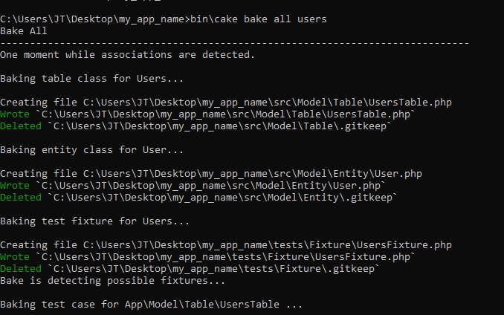
CODE GENERATION
bin\cake bake all users
bin\cake bake all internships
bin\cake bake all applications
https://book.cakephp.org/bake/2/en/usage.html

Slide 17
CONFIGURATION
/config/routes.php
<?php
use Cake\Routing\Route\DashedRoute;
use Cake\Routing\RouteBuilder;
$routes->setRouteClass(DashedRoute::class);
$routes->scope('/', function (RouteBuilder $builder) {
$builder->connect('/', array('controller' => 'home', 'action' => 'index'));
$builder->connect('/login', array('controller' => 'users', 'action' => 'login'));
$builder->connect('/register', array('controller' => 'users', 'action' => 'register'));
$builder->connect('/register/student', array('controller' => 'users', 'action' => 'registerStudent'));
$builder->connect('/register/employer', array('controller' => 'users', 'action' => 'registerEmployer'));
$builder->connect('/logout', array('controller' => 'users', 'action' => 'logout'));
$builder->fallbacks();
});

Slide 18
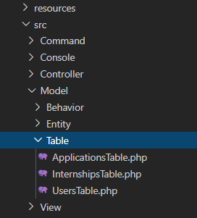
Models\Table
src/Model/Table/

Slide 19
Userstable.php
<?php
namespace App\Model\Table;
use Cake\ORM\Query;
use Cake\ORM\RulesChecker;
use Cake\ORM\Table;
use Cake\Validation\Validator;
class UsersTable extends Table
{
public $actsAs = array('Containable');
public function initialize(array $config): void
{
parent::initialize($config);
$this->setTable('users');
$this->setDisplayField('id');
$this->setPrimaryKey('id');
$this->hasMany('Applications', [
'foreignKey' => 'user_id',
]);
$this->hasMany('Internships', [
'foreignKey' => 'user_id',
]);
}

Slide 20
Validation
public function validationDefault(Validator $validator): Validator
{
$validator
->integer('id')
->allowEmptyString('id', null, 'create');
$validator
->scalar('first_name')
->maxLength('first_name', 100)
->requirePresence('first_name', 'create')
->notEmptyString('first_name');
$validator
->scalar('last_name')
->maxLength('last_name', 100)
->requirePresence('last_name', 'create')
->notEmptyString('last_name');
$validator
->email('email')
->requirePresence('email', 'create')
->notEmptyString('email');
$validator
->scalar('password')
->requirePresence('password', 'create')
->notEmptyString('password')
->add('email', 'valid-email', ['rule' => 'email']);
$validator
->integer('school_years')
->allowEmptyString('school_years');
$validator
->scalar('major')
->maxLength('major', 255)
->allowEmptyString('major');
$validator
->integer('user_type')
->requirePresence('user_type', 'create')
->notEmptyString('user_type');
$validator
->date('created_at')
->notEmptyDate('created_at');
$validator
->date('updated_at')
->notEmptyDate('updated_at');
return $validator;
}
}

Slide 21
internshipstable.php
<?php
namespace App\Model\Table;
use Cake\ORM\Query;
use Cake\ORM\RulesChecker;
use Cake\ORM\Table;
use Cake\Validation\Validator;
class InternshipsTable extends Table
{
public $actsAs = array('Containable');
public $belongsTo = array('User’);
public function initialize(array $config): void
{
parent::initialize($config);
$this->setTable('internships');
$this->setDisplayField('id');
$this->setPrimaryKey('id'); $this->belongsTo('Users', [
'foreignKey' => 'user_id',
'joinType' => 'INNER',
]);
$this->hasMany('Applications', [
'foreignKey' => 'internship_id',
]);
}
public function initialize(array $config): void
{
parent::initialize($config);
$this->setTable('internships');
$this->setDisplayField('id');
$this->setPrimaryKey('id');
$this->belongsTo('Users', [
'foreignKey' => 'user_id',
'joinType' => 'INNER',
]);
$this->hasMany('Applications', [
'foreignKey' => 'internship_id',
]);
}
public function validationDefault(Validator $validator): Validator
{
$validator
->integer('id')
->allowEmptyString('id', null, 'create');
$validator
->scalar('company_name')
->maxLength('company_name', 100)
->requirePresence('company_name', 'create')
->notEmptyString('company_name');

Slide 22
internshipstable.php
$validator
->scalar('company_location')
->maxLength('company_location', 255)
->requirePresence('company_location', 'create')
->notEmptyString('company_location');
$validator
->scalar('job_type')
->maxLength('job_type', 255)
->requirePresence('job_type', 'create')
->notEmptyString('job_type');
$validator
->scalar('pdf_url')
->maxLength('pdf_url', 255)
->requirePresence('pdf_url', 'create')
->allowEmptyString('pdf_url');
return $validator;
}
public function buildRules(RulesChecker $rules): RulesChecker
{
$rules->add($rules->existsIn(['user_id'], 'Users'), ['errorField' => 'user_id']);
return $rules;
}
// Return internships based on employers id
public function findEmployersInternships($id)
{
return $this->find()->where([
'user_id =' => $id]);
} // Return available internships
public function findAvailableInternships()
{
return $this->find('all',
[
'contain' => ['Applications']
]
);
}
}
public function initialize(array $config): void
{
parent::initialize($config);
$this->setTable('users');
$this->setDisplayField('id');
$this->setPrimaryKey('id');
$this->hasMany('Applications', [
'foreignKey' => 'user_id',
]);
$this->hasMany('Internships', [
'foreignKey' => 'user_id',
]);
}

Slide 23
Validation
public function buildRules(RulesChecker $rules): RulesChecker
{
$rules->add($rules->existsIn(['user_id'], 'Users'), ['errorField' => 'user_id']);
return $rules;
}
public function validationDefault(Validator $validator): Validator
{
$validator
->integer('id')
->allowEmptyString('id', null, 'create');
$validator
->scalar('company_name')
->maxLength('company_name', 100)
->requirePresence('company_name', 'create')
->notEmptyString('company_name');
$validator
->scalar('company_location')
->maxLength('company_location', 255)
->requirePresence('company_location', 'create')
->notEmptyString('company_location');
$validator
->scalar('job_type')
->maxLength('job_type', 255)
->requirePresence('job_type', 'create')
->notEmptyString('job_type');
$validator
->scalar('pdf_url')
->maxLength('pdf_url', 255)
->requirePresence('pdf_url', 'create')
->allowEmptyString('pdf_url'); return $validator;
}

Slide 24
Functions
// Return internships based on employers id
public function findEmployersInternships($id)
{
return $this->find()->where([
'user_id =' => $id]);
}
// Return available internships
public function findAvailableInternships()
{
return $this->find('all',
[
'contain' => ['Applications']
]
);
}
}

Slide 25
applicationstable.php
<?php
namespace App\Model\Table;
use Cake\ORM\Query;
use Cake\ORM\RulesChecker;
use Cake\ORM\Table;
use Cake\Validation\Validator;
class ApplicationsTable extends Table
{
public $actsAs = array('Containable');
public $belongsTo = array('User','Application');
public function initialize(array $config): void
{
parent::initialize($config);
$this->setTable('applications');
$this->setDisplayField('id');
$this->setPrimaryKey('id');
$this->belongsTo('Internships', [
'foreignKey' => 'internship_id',
'joinType' => 'INNER',
]);
$this->belongsTo('Users', [
'foreignKey' => 'user_id',
'joinType' => 'INNER',
]);
}

Slide 26
Validation
public function validationDefault(Validator $validator): Validator
{
$validator
->integer('id')
->allowEmptyString('id', null, 'create');
$validator
->date('created_at')
->notEmptyDate('created_at');
$validator
->date('updated_at')
->notEmptyDate('updated_at');
return $validator;
}
public function buildRules(RulesChecker $rules): RulesChecker
{
$rules->add($rules->existsIn(['internship_id'], 'Internships'), ['errorField' => 'internship_id']);
$rules->add($rules->existsIn(['user_id'], 'Users'), ['errorField' => 'user_id']);
return $rules;
}
}

Slide 27
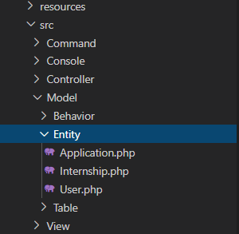
Models\Entity
src/Model/Entity/

Slide 28
User.php
<?php
namespace App\Model\Entity;
use Cake\ORM\Entity;
use Authentication\PasswordHasher\DefaultPasswordHasher;
use Authentication\IdentityInterface;
class User extends Entity implements IdentityInterface
{
protected $_accessible = [
'first_name' => true,
'last_name' => true,
'email' => true,
'password' => true,
'school_years' => true,
'major' => true,
'user_type' => true,
'created_at' => true,
'updated_at' => true,
'applications' => true,
];
protected $_hidden = [
'password',
];
/**
* Authentication\IdentityInterface method
*/
public function getIdentifier()
{
return $this->id;
}
/**
* Authentication\IdentityInterface method
*/
public function getOriginalData()
{
return $this;
}
}

Slide 29
Internship.php
<?php
namespace App\Model\Entity;
use Cake\ORM\Entity;
class Internship extends Entity
{
protected $_accessible = [
'user_id' => true,
'company_name' => true,
'company_location' => true,
'job_type' => true,
'applications' => true,
'pdf_url' => true,
];
}

Slide 30
Application.php
<?php
namespace App\Model\Entity;
use Cake\ORM\Entity;
class Application extends Entity
{
protected $_accessible = [
'internship_id' => true,
'user_id' => true,
'created_at' => true,
'updated_at' => true,
'internship' => true,
'user' => true,
];
}

Slide 31
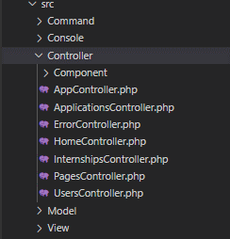
Controllers
src/Controller/

Slide 32
USERSCONTROLLER.php

Slide 33
beforefilter()
public function beforeFilter(\Cake\Event\EventInterface $event)
{
parent::beforeFilter($event);
// Allow unathorized users to use these functions
// This allows them to view the pages associated
$this->Authentication->allowUnauthenticated([
'login','register', 'registerStudent', 'registerEmployer'
]);
}

Slide 34
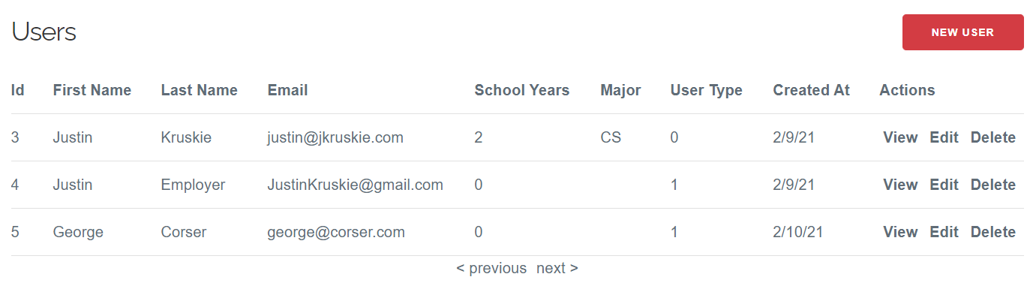
Index()
public function index()
{
// Return all users
$users = $this->paginate($this->Users);
$this->set(compact('users'));
}
/users

Slide 35
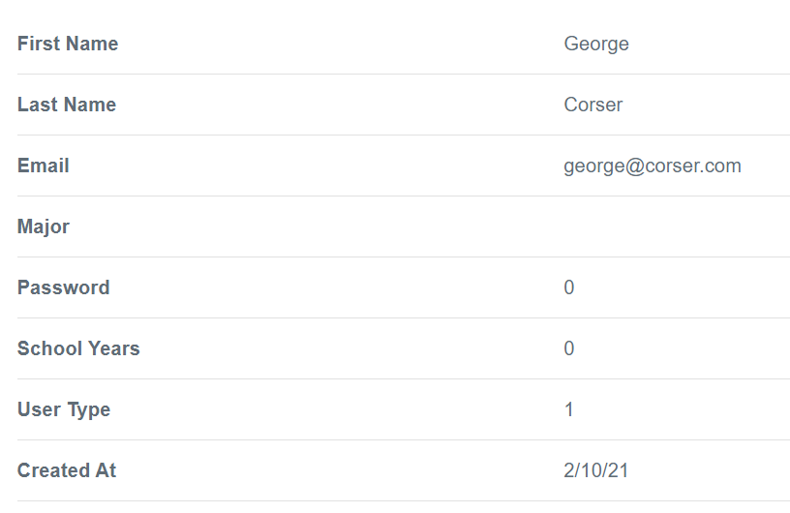
VIEW()
public function view($id = null)
{
// Get user by $id with Applications and Internships
$user = $this->Users->get($id, [
'contain' => ['Applications', 'Internships'],
]);
$this->set(compact('user'));
}
/users/view/{id}

Slide 36
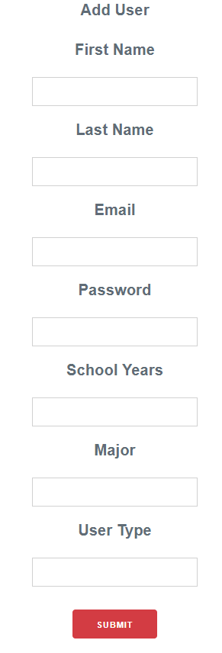
add()
public function add()
{
// Create new empty users entity
$user = $this->Users->newEmptyEntity();
if ($this->request->is('post')) {
// Fill empty user with data
$user = $this->Users->patchEntity($user, $this->request->getData());
if ($this->Users->save($user)) {
// User saved successfully
$this->Flash->success(__('The user has been saved.'));
return $this->redirect(['action' => 'index']);
}
// User save failed
$this->Flash->error(__('The user could not be saved. Please, try again.'));
}
$this->set(compact('user'));
}
/users/add

Slide 37
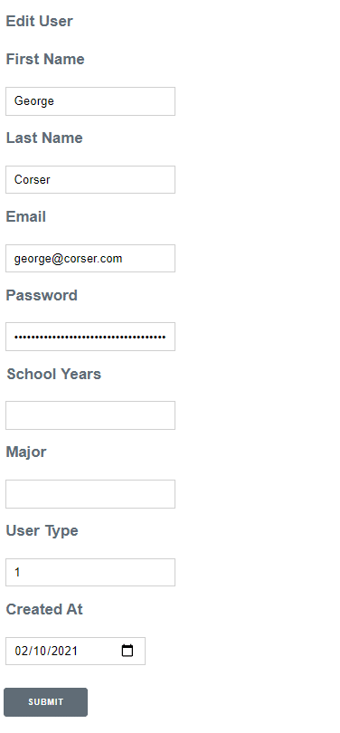
edit()
public function edit($id = null)
{
// Get user by $id
$user = $this->Users->get($id);
if ($this->request->is(['patch', 'post', 'put'])) {
// Fill user with data
$user = $this->Users->patchEntity($user, $this->request->getData());
if ($this->Users->save($user)) {
// User saved successfully
$this->Flash->success(__('The user has been saved.'));
return $this->redirect(['action' => 'index']);
}
// User save failed
$this->Flash->error(__('The user could not be saved. Please, try again.'));
}
$this->set(compact('user'));
}
/users/edit/{id}

Slide 38
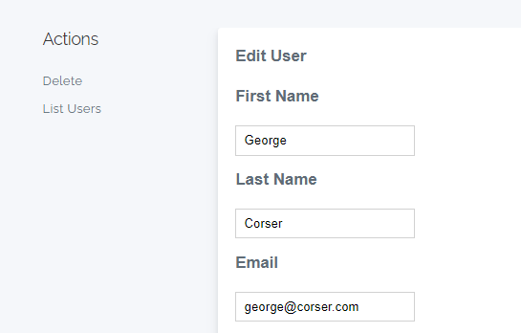
delete()
public function delete($id = null)
{
$this->request->allowMethod(['post', 'delete']);
// Get user by $id
$user = $this->Users->get($id);
if ($this->Users->delete($user)) {
// User deleted successfully
$this->Flash->success(__('The user has been deleted.'));
} else {
// User delete failed
$this->Flash->error(__('The user could not be deleted. Please, try again.'));
}
return $this->redirect(['action' => 'index']);
}
/users/delete/{id}

Slide 39
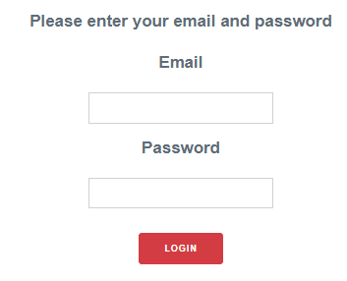
login()
public function login()
{
$result = $this->Authentication->getResult();
// If the user is logged in send them away.
if ($result->isValid()) {
// Send user to internships index
$target = $this->Authentication->getLoginRedirect() ?? '/internships';
$this->set(compact('result'));
return $this->redirect($target);
}
if ($this->request->is('post') && !$result->isValid()) {
// Authentication failed
$this->Flash->error('Invalid username or password');
}
}
/login

Slide 40
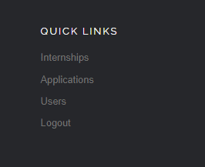
logout()
public function logout()
{
$this->Authentication->logout();
return $this->redirect("/");
}
/logout

Slide 41
register()
public function register() {
// This function doesn't actually do anything. It is only here to make the framework happy.
}
/register

Slide 42
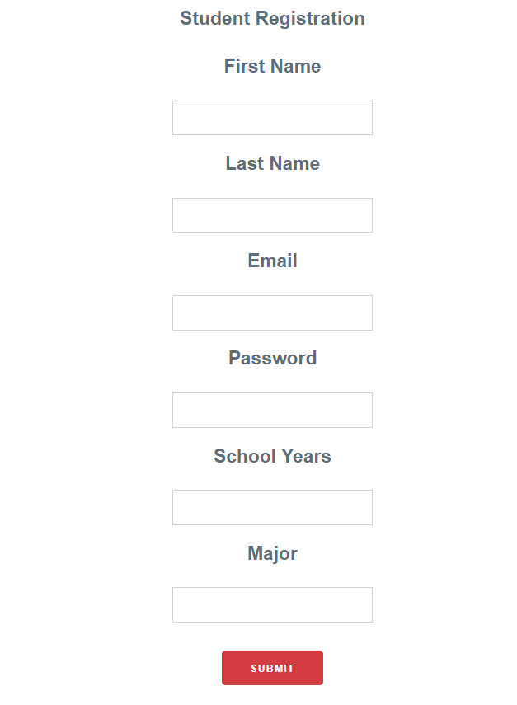
registerStudent()
public function registerStudent()
{
// Create empty user entity
$user = $this->Users->newEmptyEntity();
if($this->request->is('post')) {
$user = $this->Users->patchEntity($user, $this->request->getData());
// Set empty entity to data and user_type to student
$user['user_type'] = 0;
if($this->Users->save($user)) {
// User registration success
$this->Flash->success('You are registered and can login');
return $this->redirect(['action' => 'login']);
} else {
// User registration failed
$this->Flash->error('You are not registered');
debug($user->getErrors());
}
}
$this->set(compact($user));
}
/register/student

Slide 43
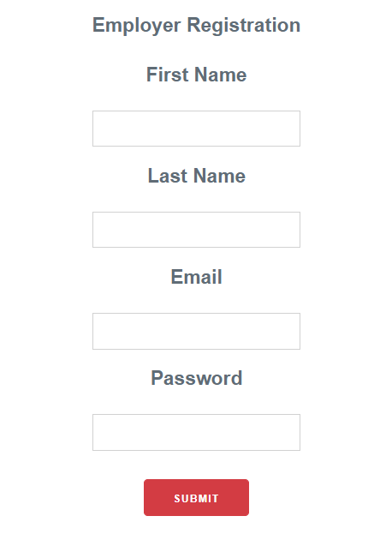
registeremployer()
public function registerEmployer()
{
// Create empty user entity
$user = $this->Users->newEmptyEntity();
if($this->request->is('post')) {
$user = $this->Users->patchEntity($user, $this->request->getData());
// Set empty entity to data and user_type to employer
$user['user_type'] = 1;
if($this->Users->save($user)) {
// User registration success
$this->Flash->success('You are registered and can login');
return $this->redirect(['action' => 'login']);
} else {
// User registration failed
$this->Flash->error('You are not registered');
debug($user->getErrors());
}
}
$this->set(compact($user));
}
/register/employer

Slide 44
INTERNSHIPSCONTROLLER.php

Slide 45
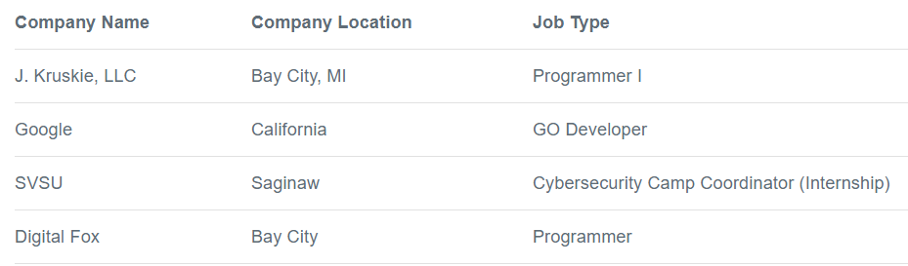
Index()
public function index()
{
$internships = null;
if($this->request->getAttribute('identity')['user_type'] == 0) {
// Student, return all
$internships = $this->paginate($this->Internships->findAvailableInternships());
} else {
// Employer, return only theirs
$internships = $this->paginate($this->Internships->findEmployersInternships($this->request->getAttribute('identity')['id']));
}
$this->set(compact('internships'));
}
/internships

Slide 46
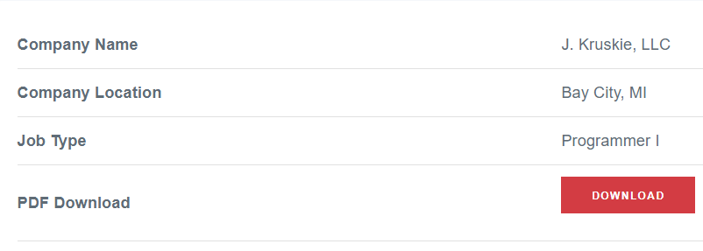
view()
public function view($id = null)
{
// Return internship of $id /w applications
$internship = $this->Internships->get($id, [
'contain' => ['Applications'],
]);
$this->set(compact('internship'));
}
/internships/view/{id}

Slide 47
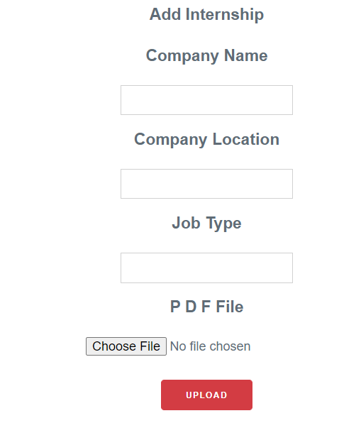
add()
public function add()
{
// Create new entity
$internship = $this->Internships->newEmptyEntity();
if ($this->request->is('post')) {
// Set internship data to the request data
$internship = $this->Internships->patchEntity($internship, $this->request->getData());
// See if there is an attached file
$files = $this->request->getUploadedFiles('file');
if($files['file']->getClientFileName() != null) {
// File is attached
// Generate a uuid for the filename
$uuid = Text::uuid() . ".pdf";
// Set the directory to save the file
$targetPath = WWW_ROOT . '/pdf/' . $uuid;
// SAve the file
$files['file']->moveTo($targetPath);
$internship->pdf_url = $uuid;
}
$internship['user_id'] = $this->request->getAttribute('identity')['id'];
if ($this->Internships->save($internship)) {
// Saved the internship
$this->Flash->success(__('The internship has been saved.')); return $this->redirect(['action' => 'index']);
}
// Save failed
$this->Flash->error(__('The internship could not be saved. Please, try again.'));
}
$this->set(compact('internship'));
}
/internships/add

Slide 48
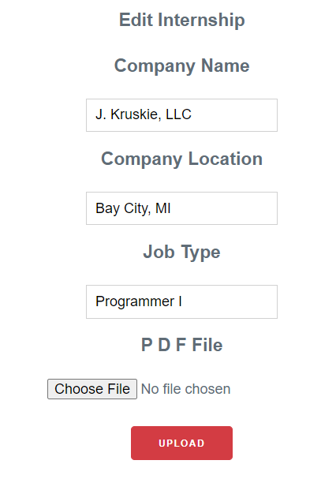
EDIT()
public function edit($id = null)
{
// Get internship of $id
$internship = $this->Internships->get($id);
if ($this->request->is(['patch', 'post', 'put'])) {
// Set internship data to the request data
$internship = $this->Internships->patchEntity($internship, $this->request->getData());
// See if there is an attached file
$files = $this->request->getUploadedFiles('file');
if($files['file']->getClientFileName() != null) {
// File is attached
// Generate a uuid for the filename
$uuid = Text::uuid() . ".pdf";
// Set the directory to save the file
$targetPath = WWW_ROOT . '/pdf/' . $uuid;
// SAve the file
$files['file']->moveTo($targetPath);
$internship->pdf_url = $uuid;
} if ($this->Internships->save($internship)) {
// Saved successfully
$this->Flash->success(__('The internship has been saved.')); return $this->redirect(['action' => 'index']);
}
// Save failed
$this->Flash->error(__('The internship could not be saved. Please, try again.'));
}
$this->set(compact('internship'));
}
/internships/edit/{id}

Slide 49
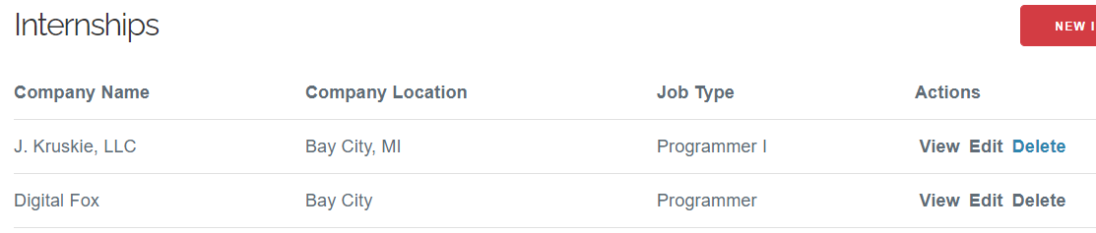
DELETE()
public function delete($id = null)
{
$this->request->allowMethod(['post', 'delete']);
// Get internship by $id
$internship = $this->Internships->get($id);
if ($this->Internships->delete($internship)) {
// Delete success
$this->Flash->success(__('The internship has been deleted.'));
} else {
// Delete failed
$this->Flash->error(__('The internship could not be deleted. Please, try again.'));
}
return $this->redirect(['action' => 'index']);
}
/internships/delete/{id}

Slide 50
HOMECONTROLLER.php

Slide 51
beforefilter()
public function beforeFilter(\Cake\Event\EventInterface $event)
{
parent::beforeFilter($event);
$this->Authentication->allowUnauthenticated(['index']);
}

Slide 52
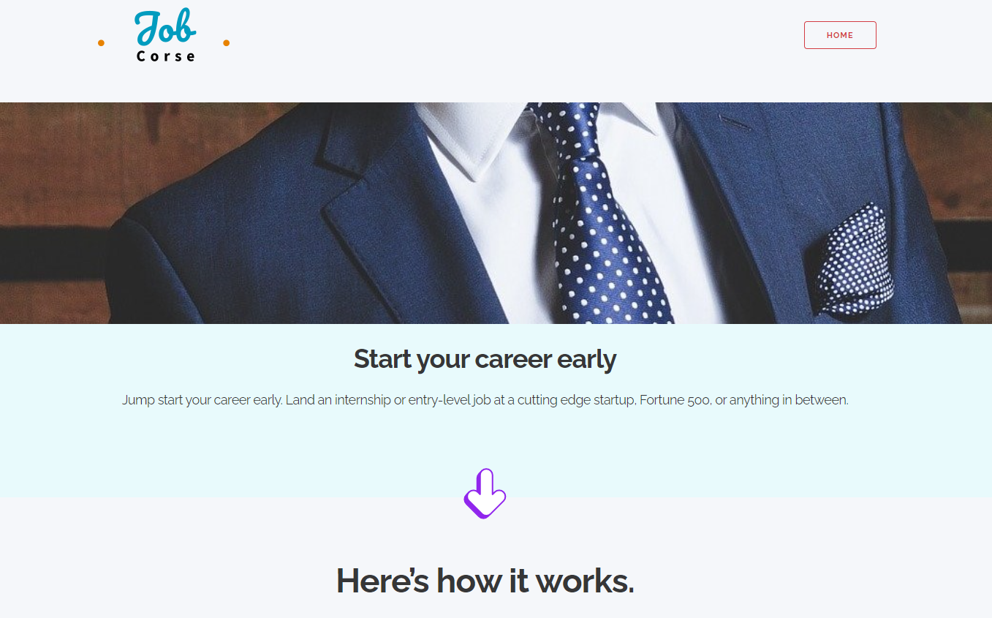
index()
public function index()
{
// Empty function to load page
}
/

Slide 53
APPLICATIONSCONTROLLER.php

Slide 54
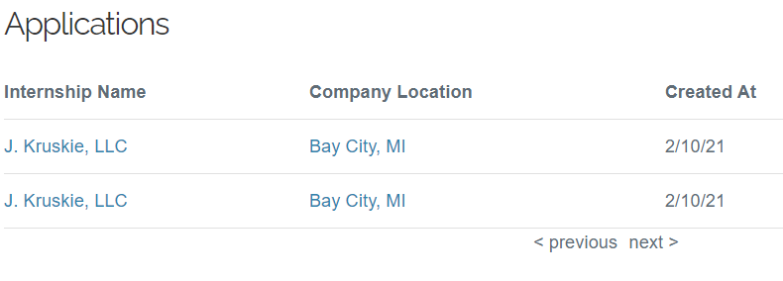
Index()
public function index()
{
// Return all applications with internships and users
$this->paginate = [
'contain' => ['Internships', 'Users'],
];
$applications = $this->paginate($this->Applications);
/applications

Slide 55
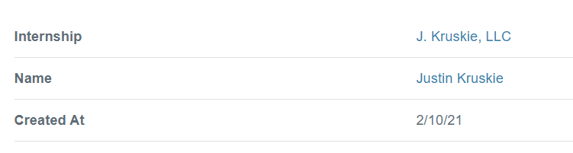
view()
public function view($id = null)
{
// Return application of $id with internships and users
$application = $this->Applications->get($id, [
'contain' => ['Internships', 'Users'],
]);
$this->set(compact('application'));
}
/applications/view/{id}

Slide 56
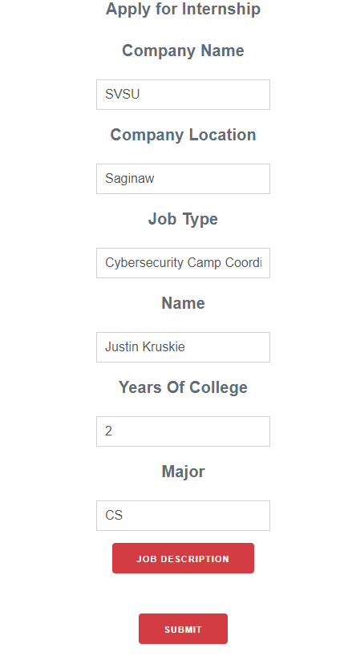
add()
public function add($id = null)
{
// Create empty application entity
$application = $this->Applications->newEmptyEntity();
if ($this->request->is('post')) {
// Assign internship id and user id manually.
$application->internship_id = $id;
$application->user_id = $this->Authentication->getIdentity()->get('id');
if ($this->Applications->save($application)) {
// Application created successfully
$this->Flash->success(__('The application has been submitted.'));
return $this->redirect(['action' => 'index']);
}
// Application creation failed
$this->Flash->error(__('The application could not be saved. Please, try again.'));
}
$internships = $this->Applications->Internships->findById($id)->all();
$this->set(compact('application', 'internships'));
}
/applications/add/{id}

Slide 57
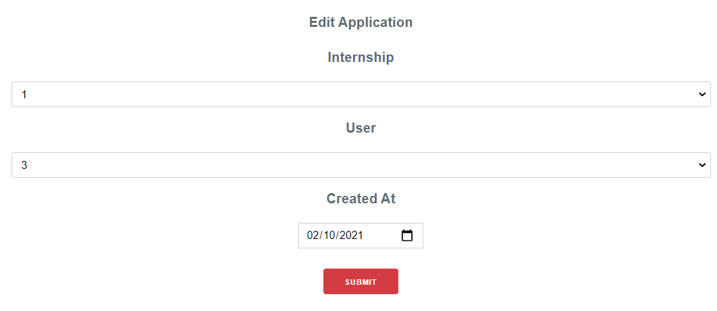
EDIT()
public function edit($id = null)
{
// Get applications by $id
$application = $this->Applications->get($id);
if ($this->request->is(['patch', 'post', 'put'])) {
// Fill entity with request data
$application = $this->Applications->patchEntity($application, $this->request->getData());
if ($this->Applications->save($application)) {
// Application updated successfully
$this->Flash->success(__('The application has been saved.'));
return $this->redirect(['action' => 'index']);
}
// Application update failed
$this->Flash->error(__('The application could not be saved. Please, try again.'));
}
$internships = $this->Applications->Internships->find('list', ['limit' => 200]);
$users = $this->Applications->Users->find('list', ['limit' => 200]);
$this->set(compact('application', 'internships', 'users'));
}
/applications/edit/{id}

Slide 58
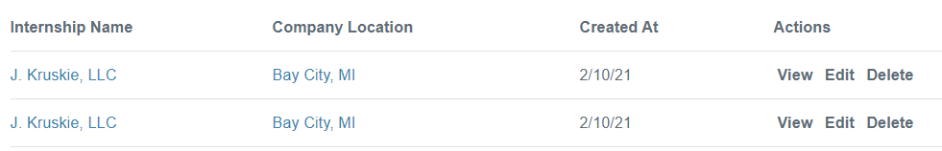
DELETE()
public function delete($id = null)
{
$this->request->allowMethod(['post', 'delete']);
// Get application by $id
$application = $this->Applications->get($id);
if ($this->Applications->delete($application)) {
// Application deleted successfully
$this->Flash->success(__('The application has been deleted.'));
} else {
// Application delection failed
$this->Flash->error(__('The application could not be deleted. Please, try again.'));
}
return $this->redirect(['action' => 'index']);
}
/applications/delete/{id}

